Slide 1
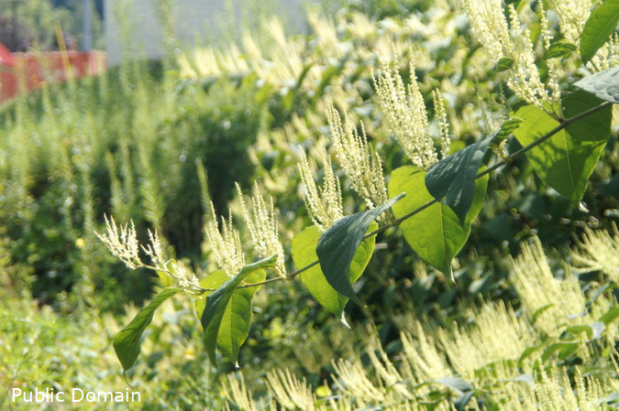



A barrier to global plant invasion ecology: gaps in trait availability for alien species
Matthias Grenié, Petr Pyšek, Franz Essl, Patrick Weigelt, Holger Kreft, Mark van Kleunen, Wayne Dawson, Ingolf Kühn, Helge Bruelheide, Marten Winter
Neobiota 2022 – Tuesday 13th of September 2022
@LeNematode
https://rekyt.github.io/

Slide 2
Alien species have strong ecological consequences
Asian knotweed
Fallopia japonica
Replaces native species
Strong effects
on ecosystem functioning
Cost to remove (in Germany)
annually ~€32.3 million (Reinhardt et al. 2003)
~1000s of alien plants
→ Need to increase our knowledge
<numéro>

Slide 3
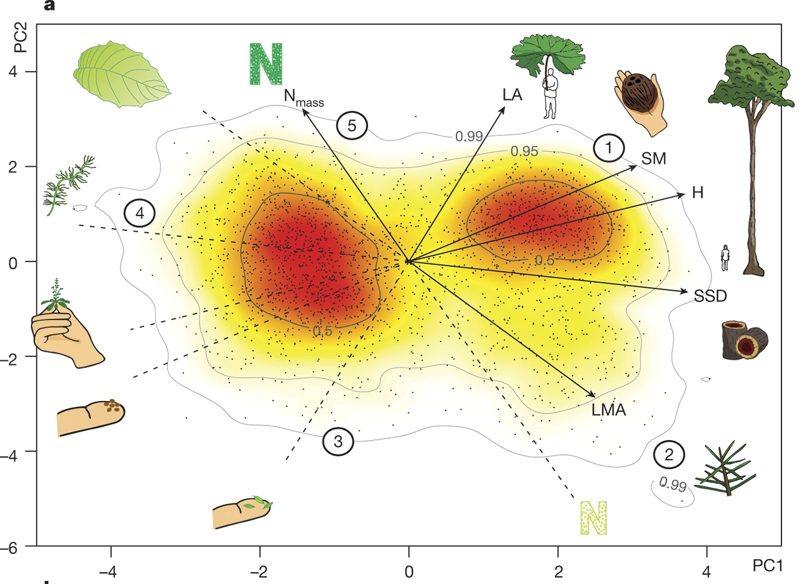
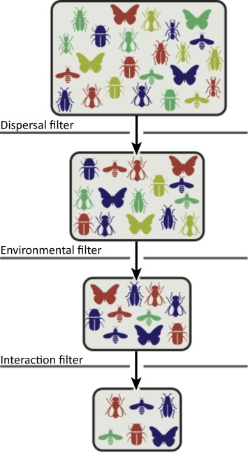
Functional Traits?
Functional traits explain community ecology
Functional traits let us gain insight
We need massive trait data on alien species
What do we know of functional traits of alien (plant) species at global scale?
<numéro>

Slide 4




Merging Alien Plant Species Lists and Global Traits
(Open) Trait Data
Alien status and distribution
Taxonomic Harmonization (Grenié et al. 2022) + Trait Harmonization + Trait Categorization
16 538 species from GloNAF → 15 490 species with at least one trait (consolidated data)
<numéro>

Slide 5
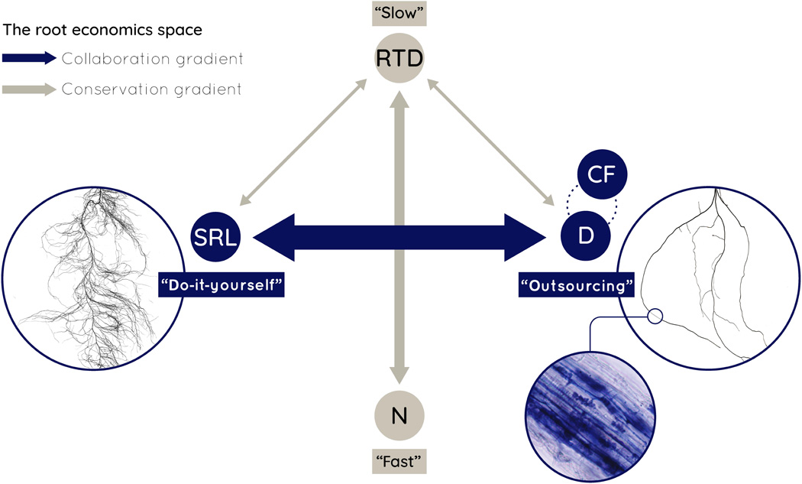
Trait Combinations
Species (15,459) x Traits (2,215) matrix is big
Reduce complexity → trait combinations
Leaf-Height-Seed Mass Westoby et al. 1999 3 traits
Aboveground Traits Díaz et al. 2016 6 traits
Root Traits Bergmann et al. 2020 4 traits
Specific Leaf Area
Height
Seed Mass
<numéro>

Slide 6
Global Trait Matrix
1 pixel = 1 trait x 1 species
98% of trait matrix is empty
<numéro>

Slide 7
20 most measured traits are mostly categorical
Most traits measured for <50% of species
Plant height is the first continuous trait
Available for ~70% of species
Seed mass is the second continuous trait
Available for ~50% of species
<numéro>

Slide 8
We know Alien Plants better in Temperate Regions
<numéro>

Slide 9
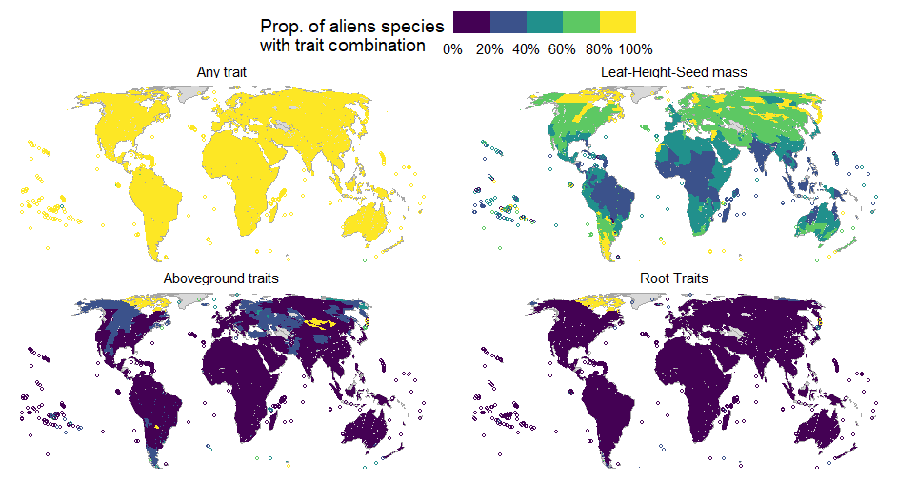
We have global gaps in trait combinations
<numéro>

Slide 10
Widespread and Invasive Species are better known
<numéro>

Slide 11
Going Further
<numéro>

Slide 12
Closing the trait gaps?
<numéro>

Slide 13
<numéro>

